Slide 1
Serials Automation tasks for summary holdings
Yoel Kortick
Senior Librarian

Slide 2

Agenda
Introduction
The connection between the item and the holdings record
The example here using a prediction pattern
The 863/4/5 and the 866/7/8 tasks
Recreating the 863/4/5 and the 866/7/8 fields
The example here not using a prediction pattern
Viewing the summary holding in Primo

Slide 3
Introduction

Slide 4
Introduction
This presentation will focus primarily on two normalization tasks for holdings records as well as a related normalization rule.
The normalization tasks are:
    MARC21 Expand Holding By 863/4/5 Task
    MARC21 Expand Holding By 866/7/8 Task
In addition to this presentation, it is highly recommended to also see accompanying PowerPoint presentation “Prediction Patterns and Serial Check-in”

Slide 5
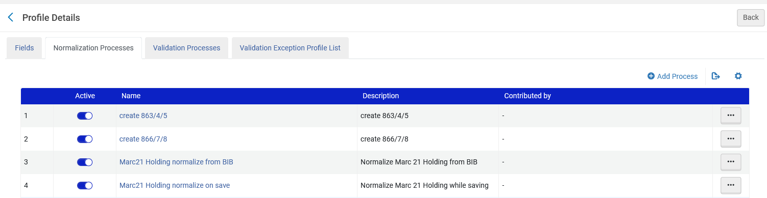
Introduction
By default, Alma provides a set of rules which occur when a holdings record is saved.
These may be viewed at Resource Management Configuration Menu > Cataloging > Metadata Configuration > Marc 21 Holding > Normalization > Marc21 Holding normalize on save

Slide 6
Introduction
In the “Task List” tab which we will show here we can see the following five tasks:
    852 field normalization
    MarcDroolNormalization
    MARC21 Expand Holding By 863/4/5 Task
    MARC21 Expand Holding By 866/7/8 Task
    marc21HoldingClearEmptyFieldsTask

Slide 7
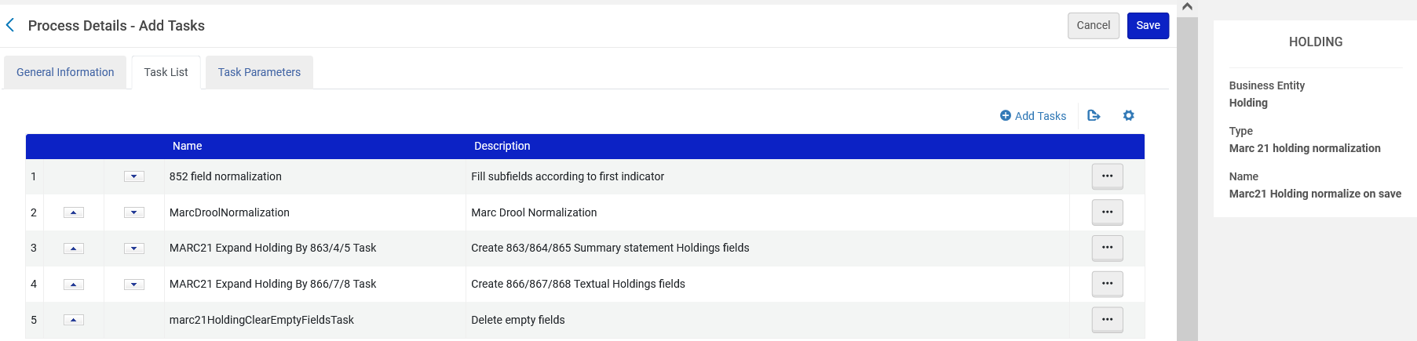
Introduction

Slide 8
Introduction
The order of the tasks in the task list, as shown in the previous slide, is very important and it is recommended that these three appear in the following order:
    MarcDroolNormalization
    MARC21 Expand Holding By 863/4/5 Task
    MARC21 Expand Holding By 866/7/8 Task

Slide 9
Introduction
The order is important because as we will see:
“MarcDroolNormalization” will remove previous 863/4/5/6/7/8 fields before creating new “up-to-date” ones
    “MARC21 Expand Holding By 863/4/5 Task” will create the 863/4/5 fields that will subsequently be used by “MARC21 Expand Holding By 866/7/8 Task”
    Because “MARC21 Expand Holding By 866/7/8 Task” uses the results of “MARC21 Expand Holding By 863/4/5 Task” it should appear after “MARC21 Expand Holding By 863/4/5 Task”

Slide 10
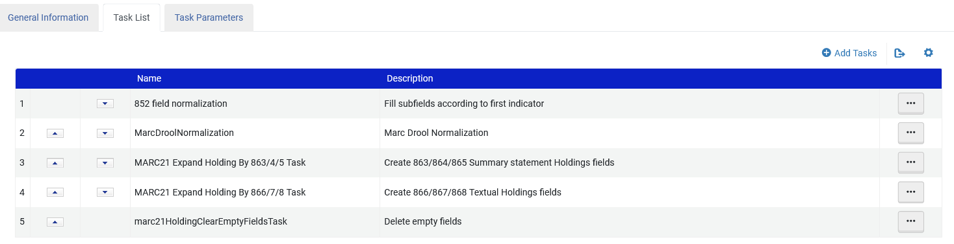
Introduction
The order of the tasks

Slide 11
Introduction
The purpose of these tasks is ultimately to create an organized 866/7/8 summary holdings statement
The summary holdings statement can then display in Primo and aid the end user in quickly and easily identifying what inventory the library holds.
For example, instead of scrolling though a big long list of items the end user can see a statement such as:
Library has: Vol. 1 (1993)– Vol. 7 (2000), Missing Vol. 3 No. 7.
Note: Some issues are in the faculty offices

Slide 12
Introduction
The end of this presentation will show an example from Primo.
Each library may customize both
The display in primo
How the 866/7/8 fields are created (for example enumeration prefixes)
Therefore, the display will not be uniform in all libraries

Slide 13
The connection between the item and the holdings record

Slide 14
The connection between the item and the holdings record
The MARC21 Expand Holding By 866/7/8 Task procedure will automatically create the 866/867/868 fields.
  The 866/867/868 are the ‘Textual Holdings’ fields
The 866/867/868 fields are created from the 853/854/855 and 863/864/865 linked fields.
The 863/864/865 fields will be created from the actual existence of the arrived items.
This will be done for the arrived items which have a link to the 853/4/5 field of the holdings record

Slide 15
The connection between the item and the holdings record
If the item is created from a prediction pattern, then the link to the 853/4/5 field of the holdings record is made automatically.
If the item is not made from a prediction pattern, then item “pattern type” and “linking number” should be updated manually.
The ENUM/CHRON tab of the Physical Item Editor:

Slide 16
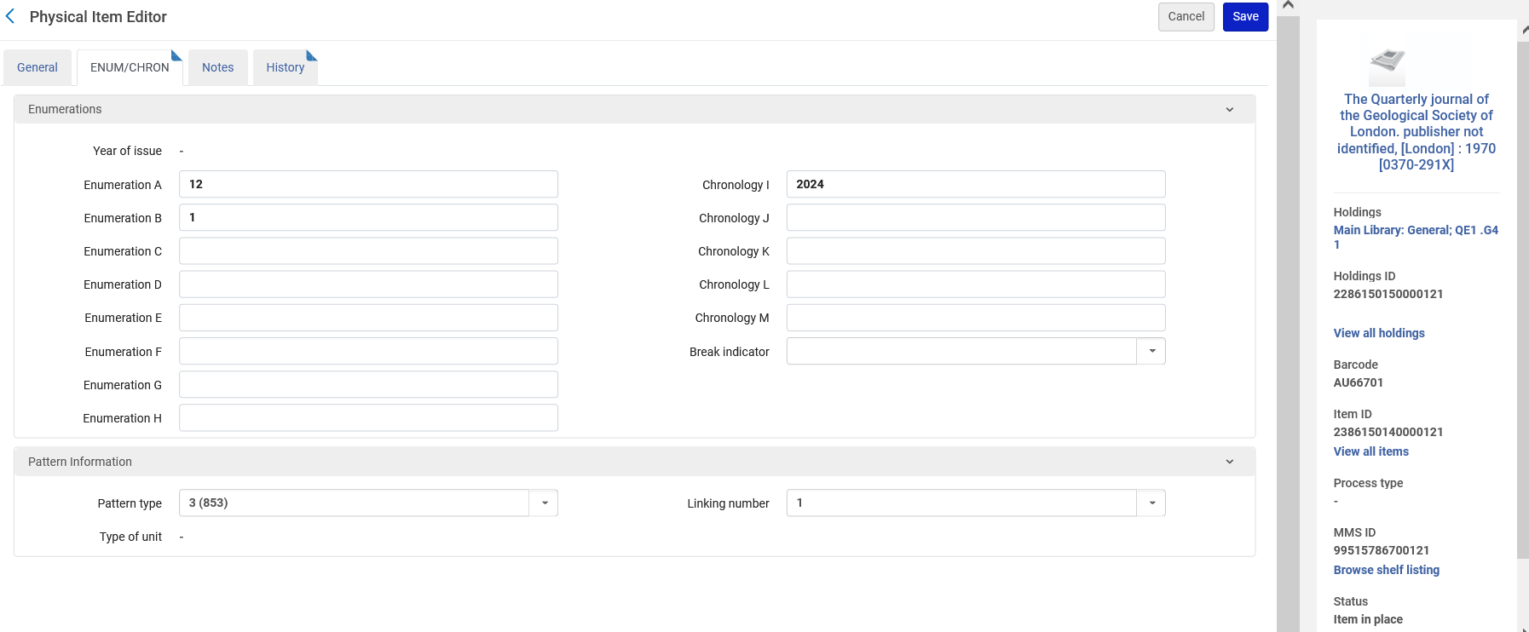
The connection between the item and the holdings record
Item is linked to this holdings record
Item is linked to this field in the holdings record

Slide 17
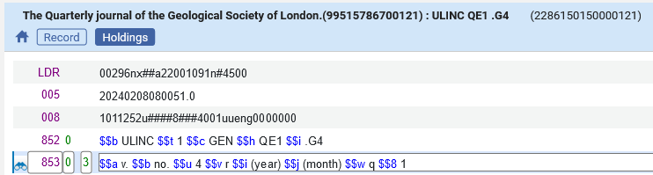
The connection between the item and the holdings record
This shows how the item is connected to the holdings record
The holdings record

Slide 18
The example here using a prediction pattern

Slide 19
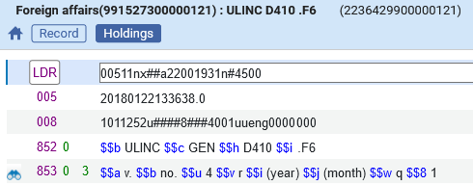
The example here using a prediction pattern
In our case we have an acquisitions order (POL-44783) for MMSID 991527300000121 ISBN 0015-7120 which is the “Foreign Affairs” journal.
Inside the holdings record we create a prediction pattern 853 field

Slide 20
The example here using a prediction pattern
In our specific situation:
  Vol. 1 2018 issues 1-4 have all arrived. It is a complete volume.
  Vol. 2 2019 issues 1 and 4 have arrived. Issues 2 and 3 are missing. It is not a complete volume.
  Vol. 3 2020 issues 1-4 have arrived. It is a complete volume.
So we have 10 issues.
All is complete for Vol. 1-3 except for issues 2 and 3 of Vol. 2 from 2019.

Slide 21
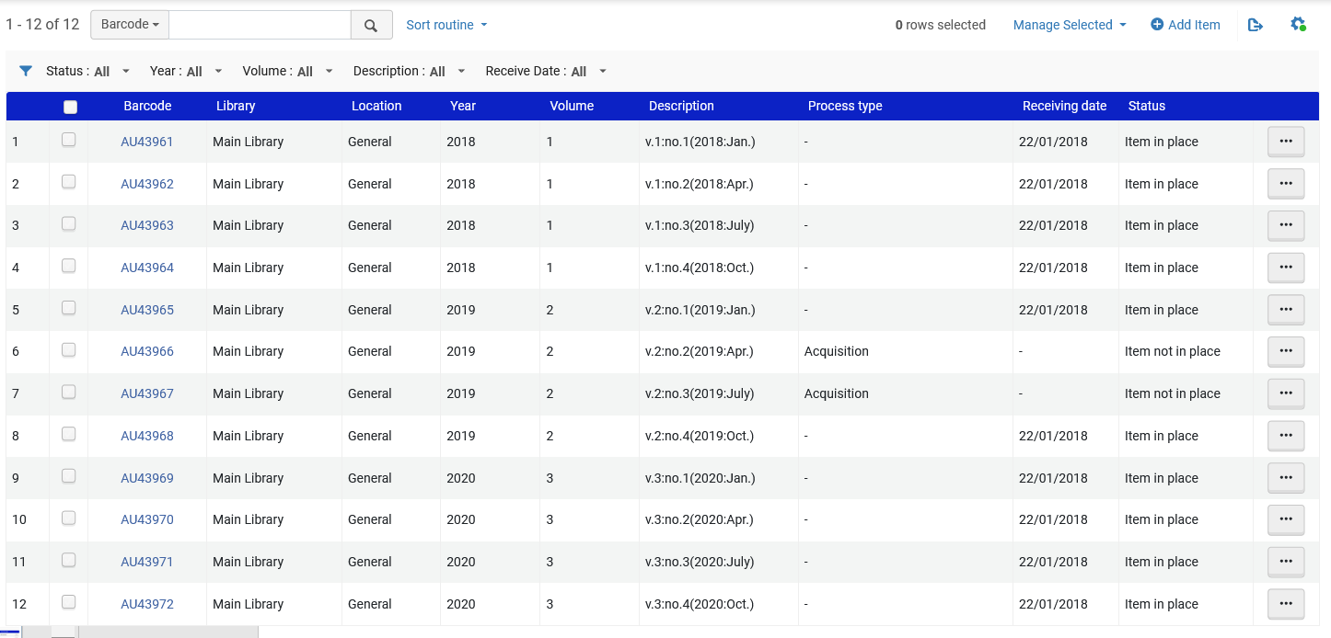
The example here using a prediction pattern
Vol. 2 issues 2-3 missing. They have no receiving date, they are “not in place” and have Process Type “Acquisition”

Slide 22
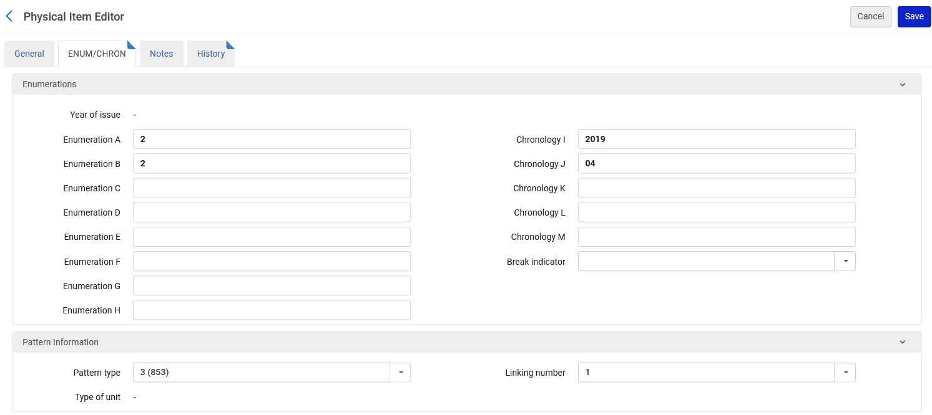
The example here using a prediction pattern
Because we used the prediction pattern to create the items each item is automatically linked to the relevant 85X field of the holdings record

Slide 23
The 863/4/5 and the 866/7/8 tasks

Slide 24
The 863/4/5 and the 866/7/8 tasks
    “MARC21 Expand Holding By 866/7/8 Task” uses the combination of the 853/4/5 and 863/4/5 to create a 866/7/8 summary holdings field
    “MARC21 Expand Holding By 863/4/5 Task” creates a 863/4/5 based on the existence and arrival of linked items.
    The 863/4/5 can be created either
      Manually
      Via the “MARC21 Expand Holding By 863/4/5 Task”
    In either case it can be used by “MARC21 Expand Holding By 866/7/8 Task” which uses the combination of the 853/4/5 and 863/4/5 to create a 866/7/8 summary holdings field

Slide 25
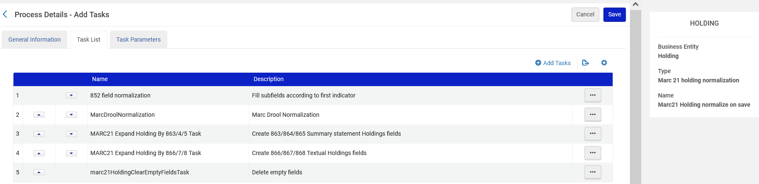
The 863/4/5 and the 866/7/8 tasks
We already saw that we have items linked to the holdings record. The items are Vol. 1-3 issues 1-4 of each volume except for issues 2-3 of volume 2
We also saw that the “Marc21 Holding normalize on save” process has “MARC21 Expand Holding By 866/7/8 Task” and “MARC21 Expand Holding By 866/7/8 Task”

Slide 26
The 863/4/5 and the 866/7/8 tasks
Therefore, when we save the holdings record, we expect that
“MARC21 Expand Holding By 863/4/5 Task” will look at which items arrived and create an 863/4/5 field from the items
“MARC21 Expand Holding By 866/7/8 Task” create new 866/7/8 fields from a combination of the new 863/4/5 fields created above and the existing 853/4/5 fields.

Slide 27
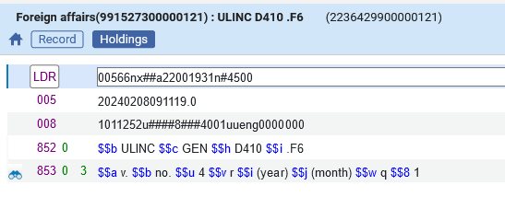
The 863/4/5 and the 866/7/8 tasks
Here is the holdings record before saving
There are no 863/4/5 or 866/7/8 fields

Slide 28
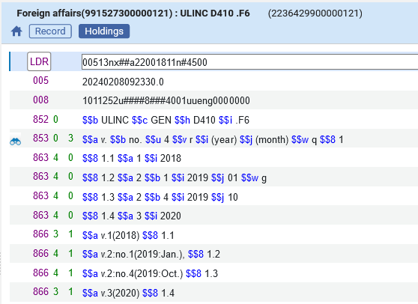
The 863/4/5 and the 866/7/8 tasks
Now we save the holdings record and watch what “magically” happens:
These 863 and 866 fields are created automatically!

Slide 29
The 863/4/5 and the 866/7/8 tasks
created from MARC21 Expand Holding By 863/4/5 Task after saving record
created from the 863 fields via the MARC21 Expand Holding By 866/7/8 Task after saving record

Slide 30
The 863/4/5 and the 866/7/8 tasks
What exactly happened?
First the 863 fields were created from the actual physical items.
Alma saw which items existed and were linked to the holdings record and made relevant 863 fields
Vol. 1 complete
Vol. 2 issue 1 with gap after it subfield w with “g”
Vol. 2 issue 4
Vol. 3 complete

Slide 31
The 863/4/5 and the 866/7/8 tasks
What exactly happened?
Next the 866 fields are created from the 863 fields. The 853 field was also used, for example to know to put “v.” as prefix to volume and “no.” as prefix to issue
Vol. 1 complete
Vol. 2 issue 1
Vol. 2 issue 4
Vol. 3 complete

Slide 32
Recreating the 863/4/5 and the 866/7/8 fields

Slide 33
Recreating the 863/4/5 and the 866/7/8 fields
Every time a record is saved a new 863/4/5 will be created (if “Marc21 Holding normalize on save” process has “MARC21 Expand Holding By 866/7/8 Task” )
But we really do not want multiple 863/4/5 fields. We want just one per set of issues which have no gap.
We also want the existing 866/7/8 fields to be removed when we save a record so that new ones can be built according to the up-to-date new 863/4/5 fields.
Therefore, we make a normalization rule which will first delete the existing 863/4/5/6/7/8 fields.

Slide 34
Recreating the 863/4/5 and the 866/7/8 fields
Here is a sample rule. We do not however delete all 863/4/5/6/7/8/9. We delete only those without a 9 in subfield 8 because we may have “local” 86X fields
rule "delete 863 4 5 6 7 8 if it does not have subfield 8 9"
when
(TRUE)
then
removeField "863" if (not exists "863.8.9")
removeField "864" if (not exists "864.8.9")
removeField "865" if (not exists "865.8.9")
removeField "866" if (not exists "866.8.9")
removeField "867" if (not exists "867.8.9")
removeField "868" if (not exists "868.8.9")
end
This will prevent local fields from getting deleted

Slide 35
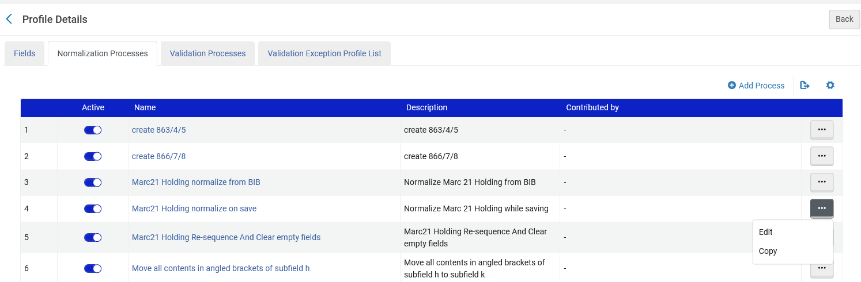
Recreating the 863/4/5 and the 866/7/8 fields
The rule is then added to the “Marc21 Holding normalize on save”.

Slide 36
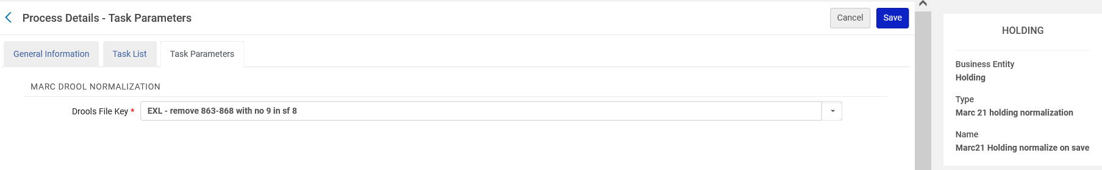
Recreating the 863/4/5 and the 866/7/8 fields
The rule is then added to the “Marc21 Holding normalize on save”.

Slide 37
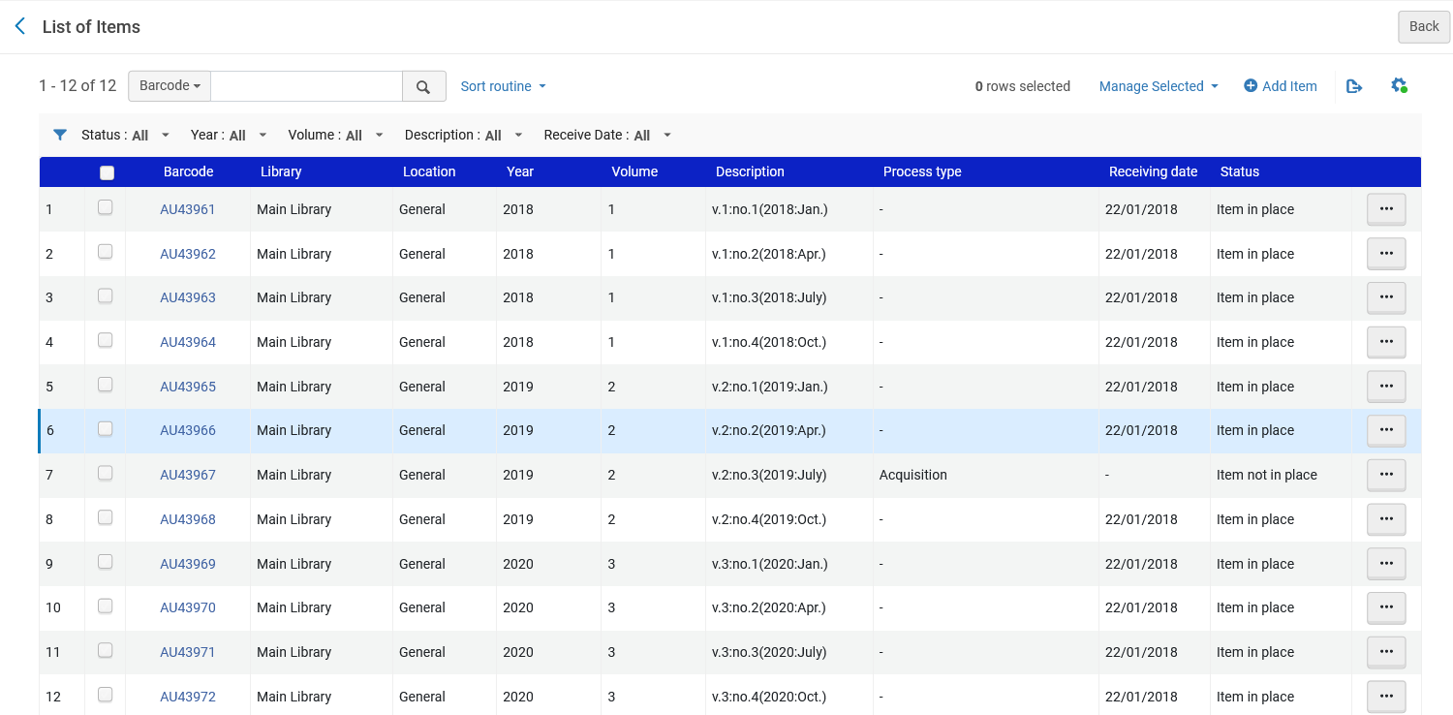
Recreating the 863/4/5 and the 866/7/8 fields
Now, for example, Vol. 2 issue 2 arrives

Slide 38
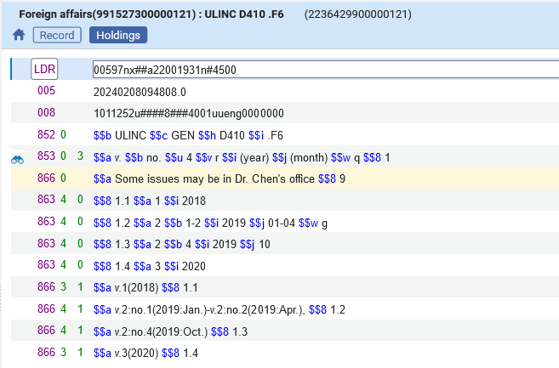
Recreating the 863/4/5 and the 866/7/8 fields
The Holdings record is saved and if we have a local 866 field it is not deleted (because it has subfield 9) and the 863 and 866 is updated with the item
Local field with $$8 9 is not deleted
Vol. 2 Iss. 2 arrived

Slide 39
The example here not using a prediction pattern

Slide 40
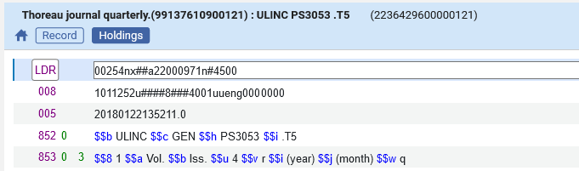
The example here not using a prediction pattern
Now we have serial “Thoreau journal quarterly”.
It has a holding record with an 853 as follows:
853 ‡8 1 ‡a Vol. ‡b Iss. ‡u 4 ‡v r ‡i (year) ‡j (month) ‡w q
It has no acquisitions order or prediction pattern

Slide 41
The example here not using a prediction pattern
The functionality shown here can still be used even without a prediction pattern as long as the items have
A receiving date
Pattern type
Linking number

Slide 42
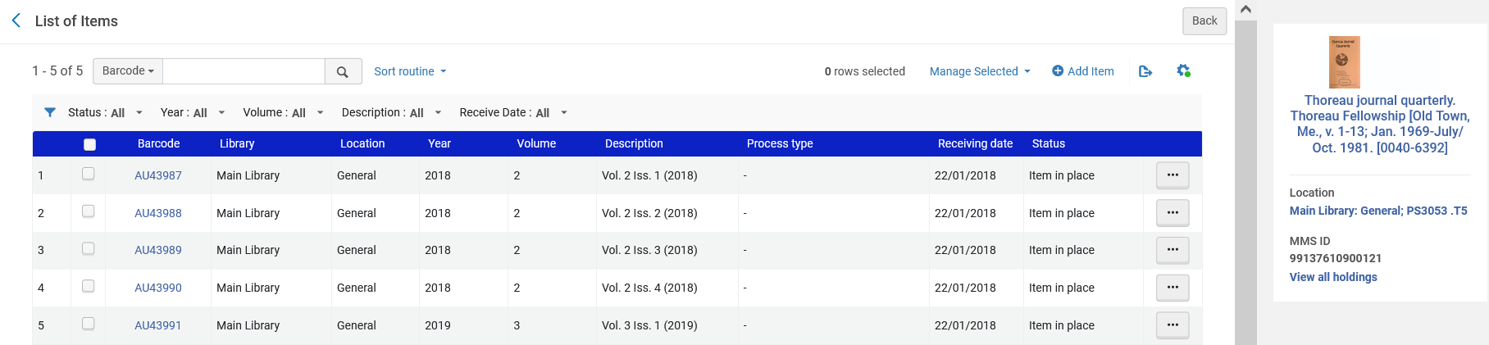
The example here not using a prediction pattern
The library has
  Volume 2 from 2018, issues 1-4
  Volume 3 from 2019, issue 1
All have a receiving date

Slide 43
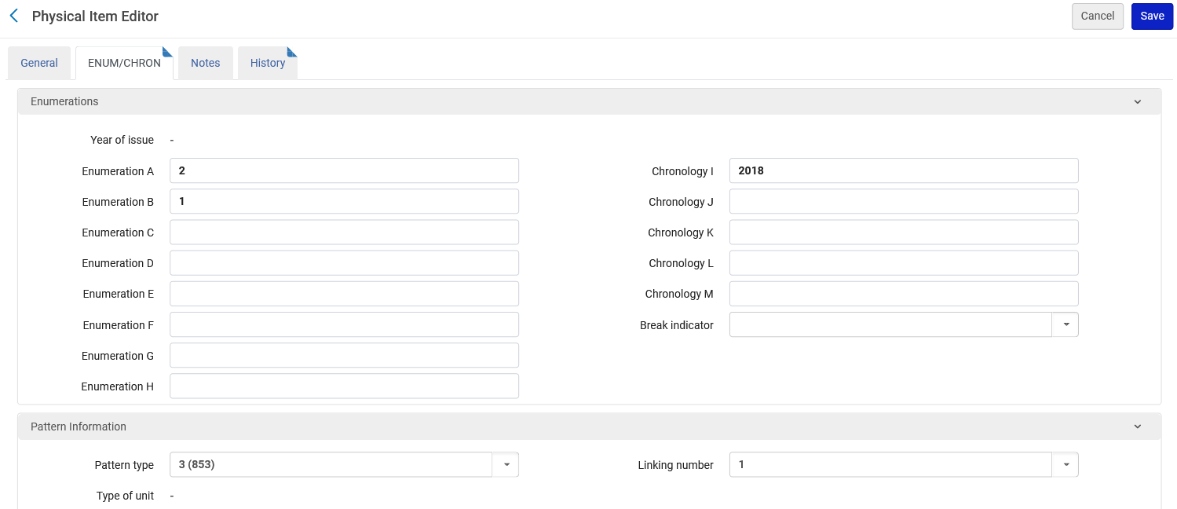
The example here not using a prediction pattern
All issues are linked to the 853 field of the holding record

Slide 44
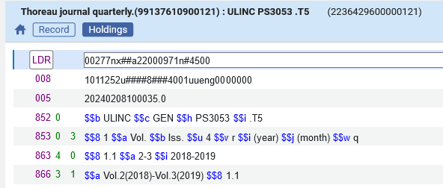
The example here not using a prediction pattern
When the holding record is saved the 863 and 866 is automatically created

Slide 45
Viewing the summary holding in Primo

Slide 46
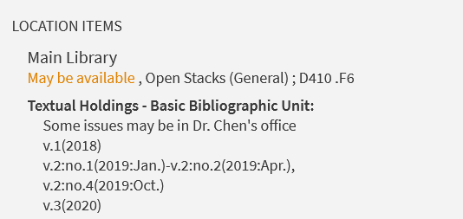
Viewing the summary holding in Primo
Here are the textual holdings for ISSN 00157120 “Foreign Affairs”

Slide 47
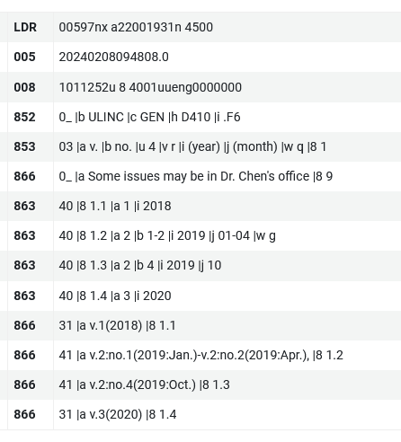
Viewing the summary holding in Primo
Here we can see the data in Primo from the Alma holdings record

